Slide 1















Speech Emotion Recognition
Presented by Juswanth T

Slide 2
The Flow
Ø SER Introduction
Ø Hubert
Ø My Implementation

Slide 3
Nowadays Solution
SER Introduction
Self-supervised learning
Pre-trained on large amounts of unlabeled audio data.
Effectively capture knowledge of audio before implementing the model into downstream tasks.
Self-supervised approaches can usually outperform traditional speech recognition
Speech Emotion Recognition, abbreviated as SER, is the act of attempting to recognize human emotion.

Slide 4
HuBERT
Self-Supervised Learning: Unlike models trained on directly labeled data for emotions, HuBERT doesn't require explicit emotion labels. Instead, it learns powerful representations of speech by predicting masked portions of the raw audio waveform.
Masked Language Modeling: During training, HuBERT masks random parts of the audio input and attempts to predict the masked portions based on the surrounding context. This process forces the model to learn comprehensive representations of speech that capture not just the content but also the speaker's characteristics and potentially emotional cues.
Clustering: HuBERT incorporates a clustering step in its training process. By grouping similar masked segments together, HuBERT learns to differentiate between different speech patterns, potentially aiding in emotion recognition

Slide 5
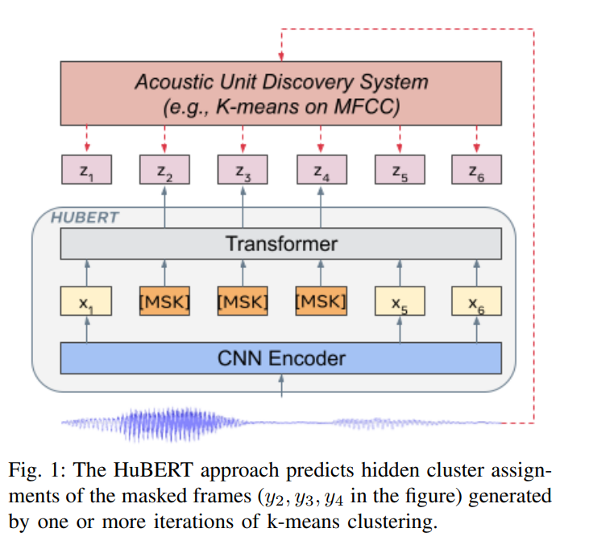

Slide 6
My Implementation
Model Selection:
HuBERT (The model I used has already been fine-tuned on IEMOCAP dataset.)
Deep Learning Framework: PyTorch and HuggingFace
Dataset: RAVDESS

Slide 7
Thank you very much!

